Slide 1
Book Recommendation System

Slide 2
Raw Data Info
Is used the dataset from Amazon as json
Is converted json to DataFrame
Row: 83057
Columns: 102
bool(11)
float64(16)
int64(7)
object(68)

Slide 3
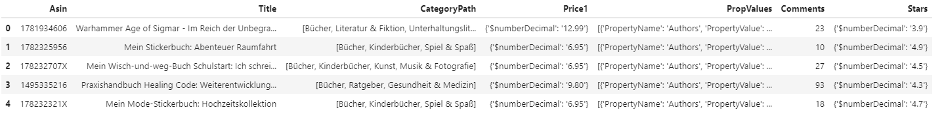
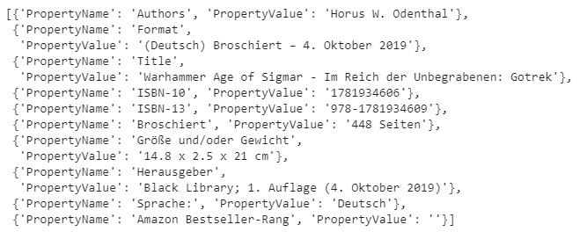
Data Cleaning
Selected Columns:
Asin: Unique Id of book
Title : Book Title
CategoryPath : Genre of book
Price1 = Price of Book
Comments = # of comments for book
Stars = Average of Book rating rated by users
PropValues = complicated:(

Slide 4
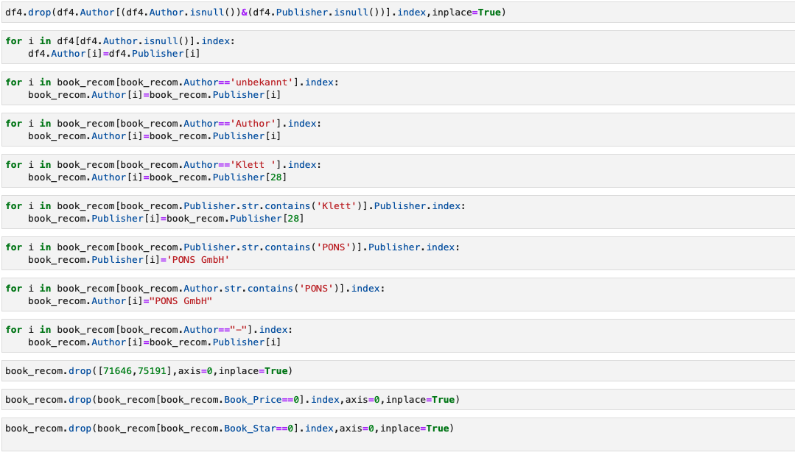
Cleaning Steps
Author, Publisher, Num of Page, Publication year of books are added from Propvalue columns

Slide 5
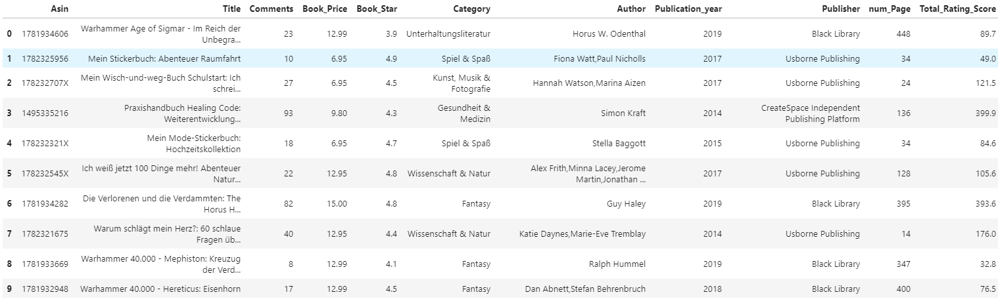
Cleaned Data

Slide 6
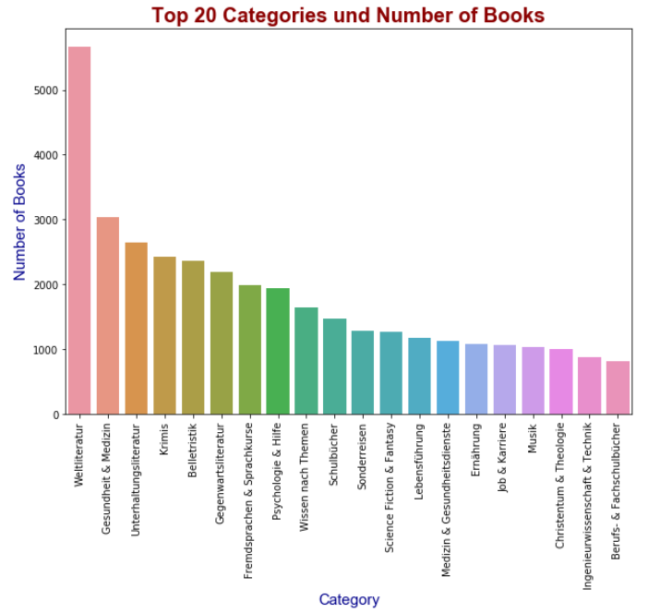

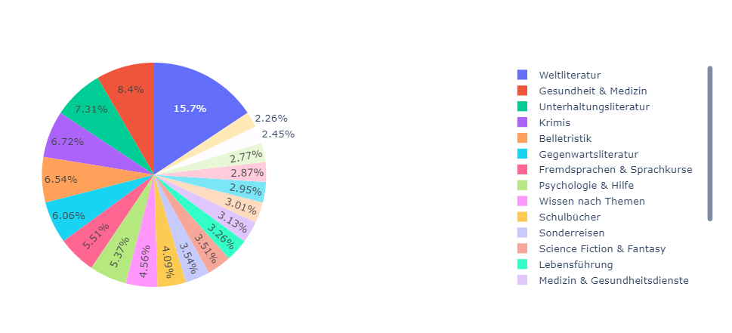
Visualization
Distribution of Top 20 Categories

Slide 7
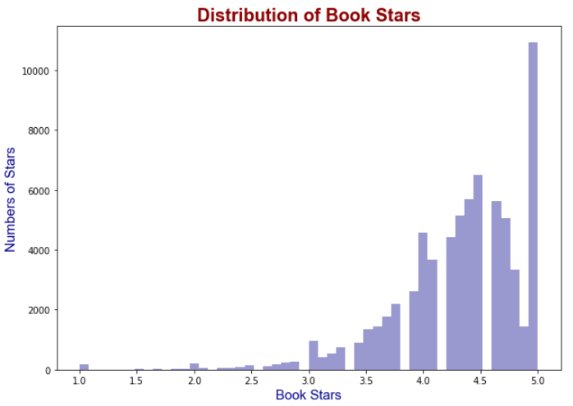
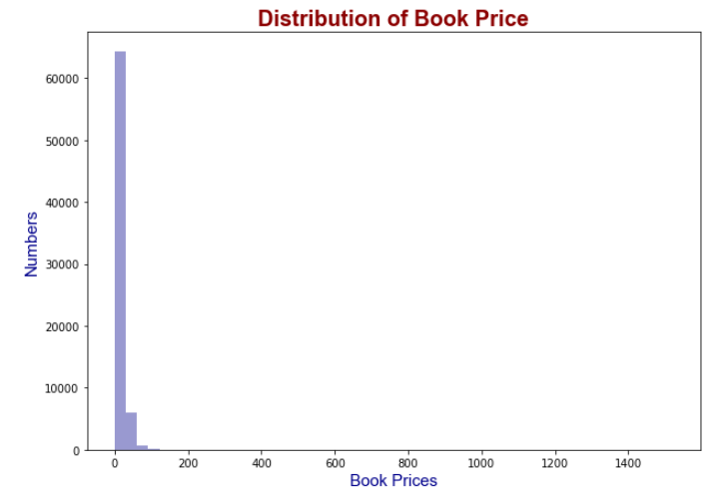
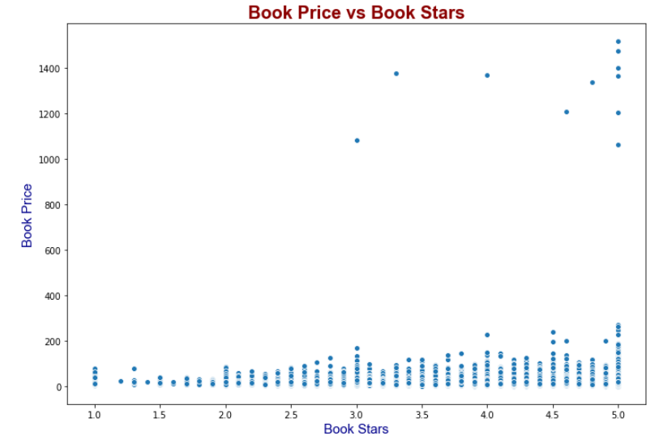
Visualization
Distribution of Books Stars and Book Price

Slide 8
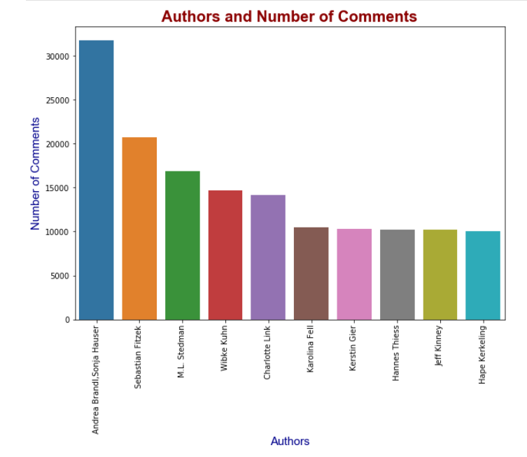
Visualization
Authors and Number of Comments

Slide 9
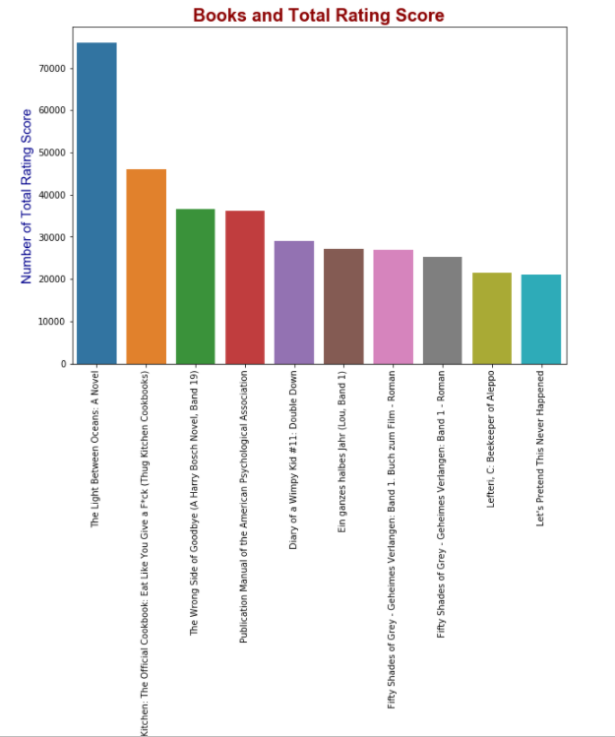
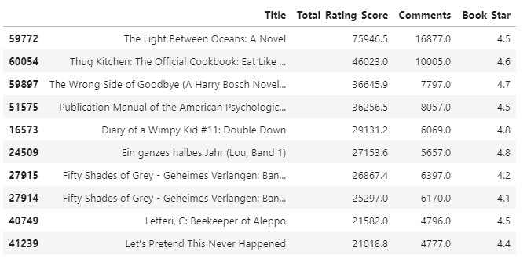
Visualization
Books and Number of Total Ratings Score

Slide 10
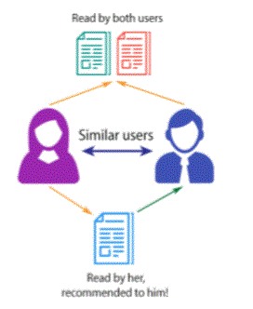
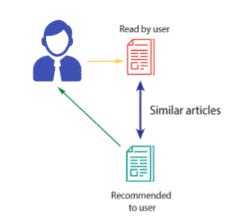
Recommendation Systems
Collaborative Filtering
User based filtering
Item based filtering
Content Based Filtering

Slide 11
Recommendation Systems
Book Title Column is cleaned
Lowercase
Stopwords
All except Letters
Frequent & Rare Words Removal
German Tokenization
German Lemmatization
Word2vec
Cosine Similarity Matrix
Row: 70K+
Columns: 420

Slide 12




Word2vec Similarity Examples
Recommendation Model

Slide 13
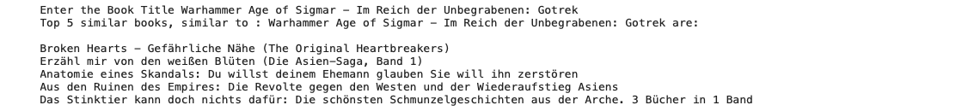
Model Prediction Example
Entered Book Title: “Warhammer Age of Sigmar - Im Reich der Unbegrabenen: Gotrek”
Word2vec:

Slide 14
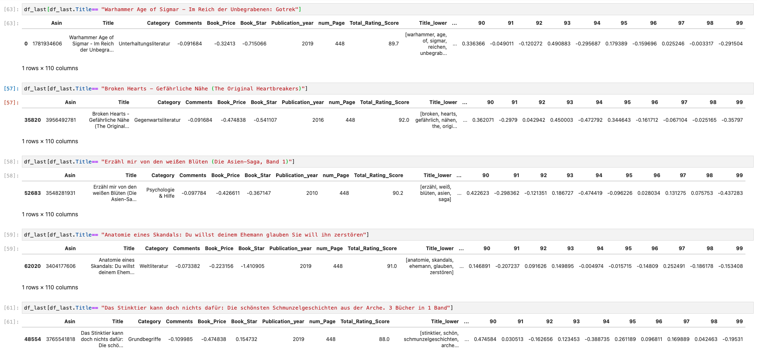
Word2vec:

